Slide 1
WINDOW FUNCTIONS
Analyzing Tesla (TSLA) and NVIDIA (NVDA) stock prices
Explainer Video • R • Time-Series Analysis
Notes:
Introduce the project. The assignment uses time-series data for Tesla and NVIDIA and applies window functions in R to calculate a year-to-date average and a six-day moving average.

Slide 2
3. Import and prepare the data
Make sure R understands the Excel files and the dates.
library(readxl)
library(dplyr)
library(lubridate)
library(slider)
library(ggplot2)
tsla <- read_excel("TSLA.xlsx")
nvda <- read_excel("NVIDIA.xlsx")
stock_data <- stock_data %>%
mutate(date = as.Date(date)) %>%
arrange(item, date)
Window Functions • TSLA + NVDA | 4
Notes:
Explain the setup. Packages are installed once in the RStudio Console, but the R Markdown document only loads them with library(). After import, dates are converted to Date format and observations are sorted by stock and date.

Slide 3
5. Year-to-Date average
YTD means: average from the beginning of the year up to the current date.
stock_data <- stock_data %>%
group_by(item, year) %>%
mutate(
ytd_average = cummean(price)
) %>%
ungroup()
How to read it
group_by(item, year) keeps TSLA and NVDA
separate and restarts the cumulative calculation each year.
cummean(price) updates the average as time moves forward.
Example: 100 → 110 → 120 → 130 | YTD averages: 100 → 105 → 110 → 115
Window Functions • TSLA + NVDA | 6
Notes:
Use a simple example. If prices are 100, 110, 120, and 130, the cumulative averages are 100, 105, 110, and 115. When the year changes, the calculation restarts. group_by(item, year) and cummean(price) implement this.

Slide 4
6. Six-day moving average
Today + the previous five trading days = a six-day window.
stock_data <- stock_data %>%
group_by(item) %>%
mutate(
six_day_average = slide_dbl(
price, mean,
.before = 5,
.complete = TRUE
)
) %>%
ungroup()
1
2
3
4
5
6
The window moves forward one observation at a time.
.before = 5
.complete = TRUE
Current observation + five previous observations = six total.
The first five rows wait until a complete six-day window exists,
so they are NA.
Window Functions • TSLA + NVDA | 7
Notes:
Explain slide_dbl. The current day is included, and .before = 5 adds five previous observations. That gives six observations. .complete = TRUE means R does not calculate partial windows, so the first five observations have NA for this measure.

Slide 5
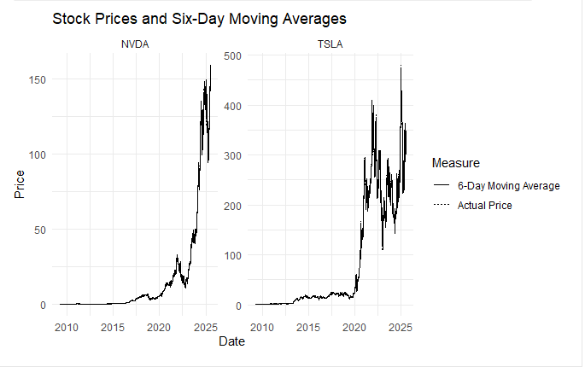
7. Visualization: what does the graph show?
The moving average smooths short-term daily fluctuations.
NVDA
Left panel: NVIDIA actual prices and
six-day moving average.
TSLA
Right panel: Tesla actual prices and
six-day moving average.
Main idea
The moving average is smoother because
it uses six observations.
Window Functions • TSLA + NVDA | 8
Notes:
Explain the actual graph. NVDA is on the left and TSLA is on the right. The dotted line is actual price and the solid line is the six-day moving average. The moving average is smoother because it averages six trading observations.

Slide 6
9. Conclusion
Window functions turn daily stock data into useful time-based measures.
TSLA + NVDA → clean time series → YTD + 6-day windows → visualization
• I used R to work with two separate stock time series.
• The YTD average provided a cumulative measure within each year.
• The six-day moving average provided a short-term smoothed measure.
• The project helped me understand how window functions can be applied to time-series data.
Window Functions • TSLA + NVDA | 10
Notes:
Conclude by connecting the work to the assignment. I used two time series, calculated a cumulative YTD average and a six-day rolling average, and visualized the results. The main takeaway is how window functions support time-series analysis.

Slide 7
THANK YOU
Window Functions with Tesla (TSLA) and NVIDIA (NVDA)
AI Use
ChatGPT was used as a supporting tool to assist with data analysis, R coding, and visualization development. All AI-generated code and analytical suggestions were reviewed, tested, and monitored by me.
Notes:
Thank the viewer. If required, briefly explain that AI was used as a supporting tool and that the final code and analytical suggestions were reviewed and tested.

